Slide 1
Stacks

Slide 2
Agenda
Stacks
Stack operation and principles
Stack Push algorithm
Stack Pop algorithm
Stacks example

Slide 3
Stacks
Stack is where Insertion and deletion of elements happens from one side of the list. Stacks take Last In First Out Approach (LIFO).
Example: CD/DVD spindle box.
Insertion
Deletion

Slide 4

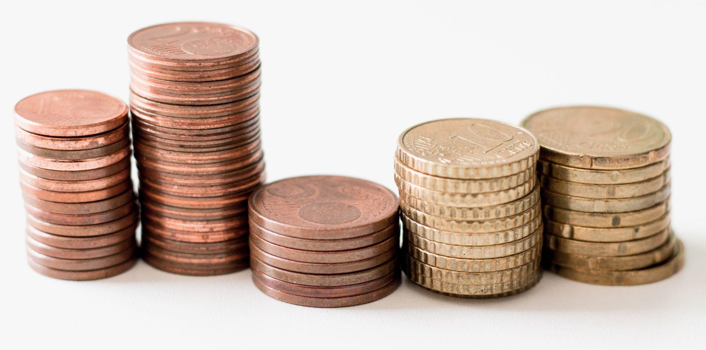

Stacks real world example

Slide 5
Stack operations and principles
Principles
Insertion
Deletion
Operations
IsEmpty
IsFull
Push
Pop

Slide 6
Stack Push algorithm
Start
Declare variables Size_of_stack, current_pointer = -1.
if (current_pointer >= (Size_of_stack - 1)) {
Print Stack Overflow
else
a[++current_pointer ] = x; //a[ ] = stack array
// x is pushed element
Stop

Slide 7
Stack Pop algorithm
Start
Declare variables Size_of_stack, current_pointer = -1.
if (current_pointer < 0)
Print Stack underflow
else
int x = a[current_pointer --]; // x is the popped element
return x; // a[ ] = stack array
Stop

Slide 8
Stacks example
Insert 2,45,65,21 to stack and perform delete operation on all elements.
Insertion
2
45
2
65
45
2
21
65
45
2
Current pointer
Current pointer
Current pointer
Current pointer
Current pointer

Slide 9
Stacks example
Insert 2,45,65,21 to stack and perform delete operation on all elements.
Deletion
65
45
2
45
2
2
Current pointer
Current pointer
Current pointer
Current pointer

Slide 10
Summary
We understood what stacks are along with its operations and principles.
We have also seen algorithm for push and pop operations with an example.

Slide 11
Thank You
Proprietary content. ©Great Learning. All Rights Reserved. Unauthorized use or distribution prohibited

